Slide 1



Corona Virus Analysis Using SQL

Slide 2

Introduction
The COVID-19 pandemic has had a profound impact globally. This project aims to analyze a COVID-19 dataset using SQL to gain insights into the virus's spread, impact, and recovery trends. By examining geographic data, confirmed cases, deaths, and recoveries, we aim to provide valuable information for better decision-making and strategy development in managing the pandemic.

Slide 3

Aim and Objective
1
Aim
2
Objectives
Utilize SQL and data analysis to derive insights from the COVID-19 dataset.
1. Identify patterns in the geographic spread of cases.
2. Evaluate the impact on public health across regions.
3. Provide data-driven recommendations for pandemic management.

Slide 4
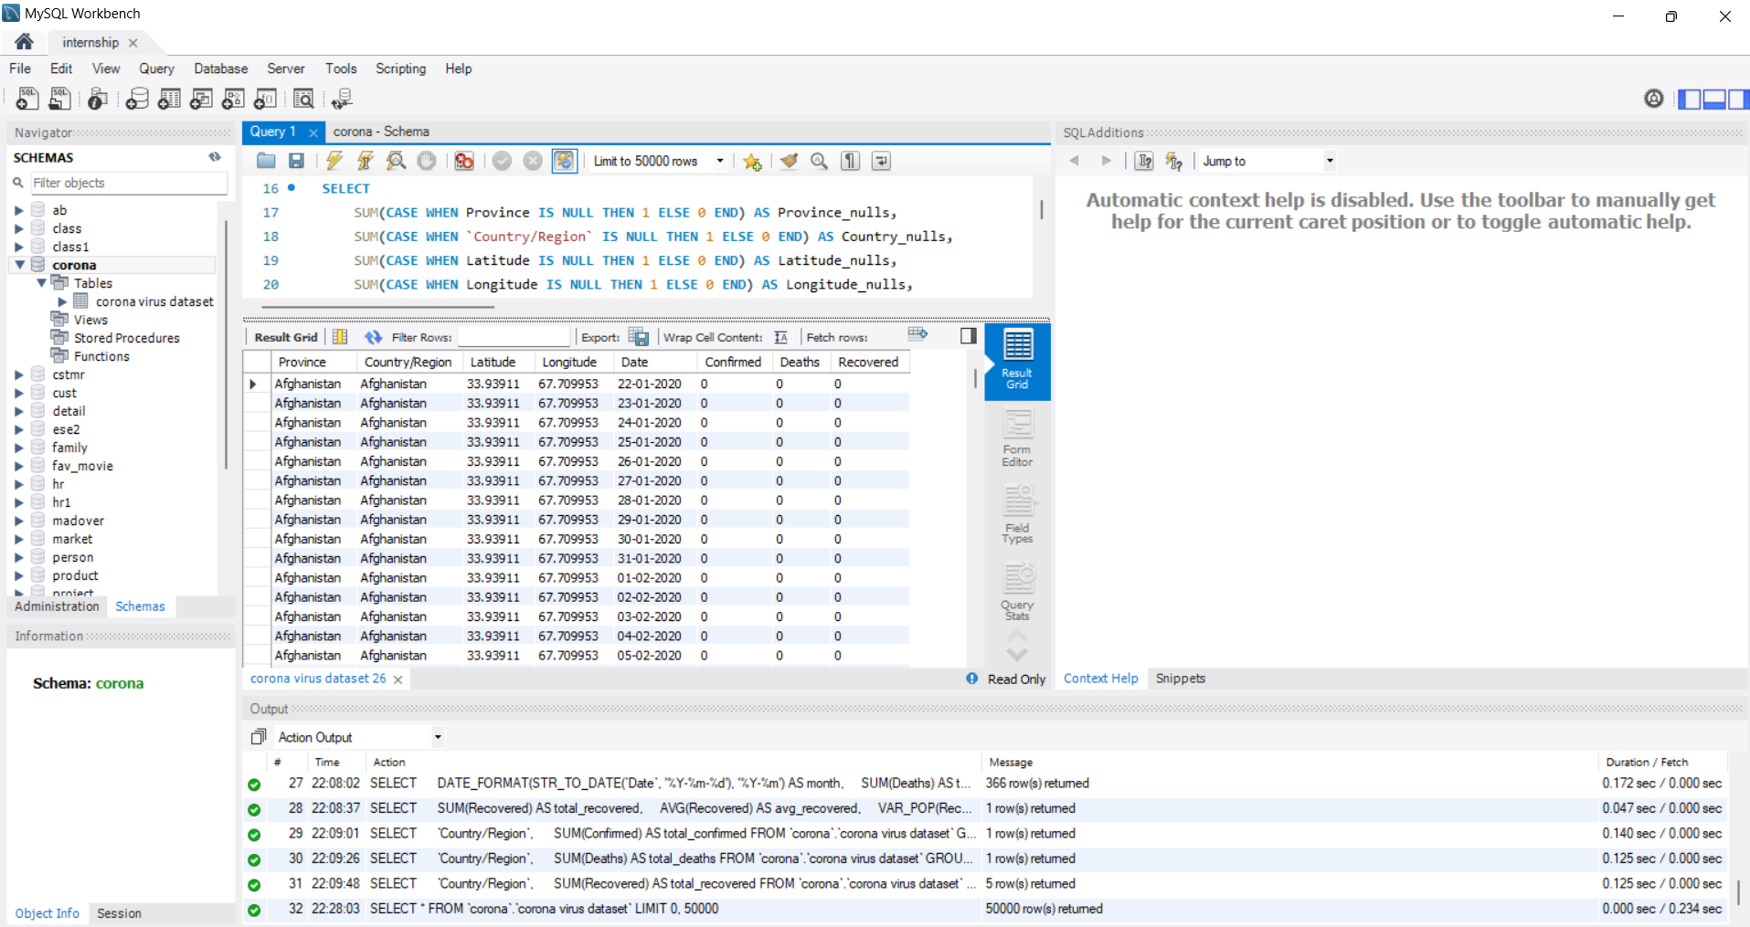
How to Add Data in MySQL Workbench
1
Connect to MySQL Workbench
Open MySQL Workbench and connect to your server.
2
Create a Schema
In the Navigator panel, right-click 'Schemas' and select 'Create Schema'. Name your schema and click 'Apply'.
3
Import Data
Right-click the schema name and select 'Table Data Import Wizard'. Browse and select your CSV file. Verify data types and click 'OK' to import.

Slide 5
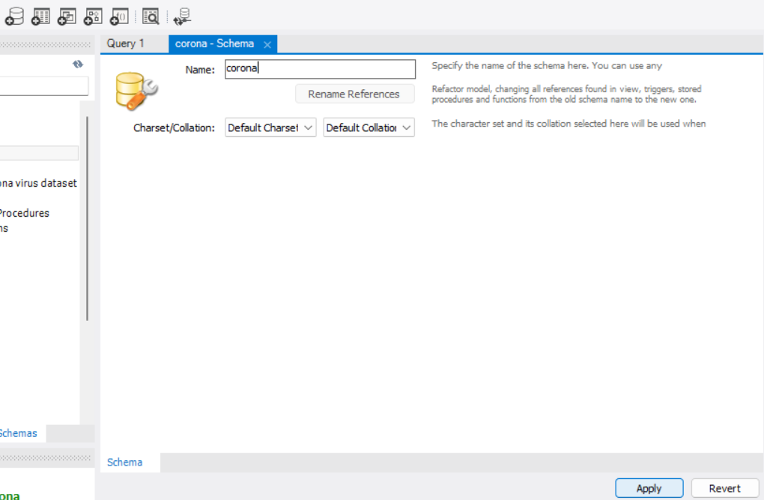
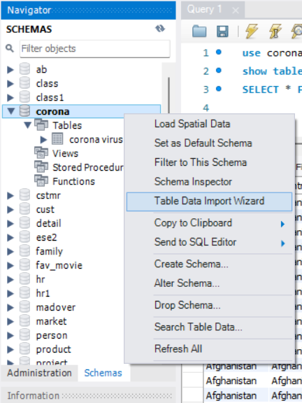
Step-1
Step-2

Slide 6
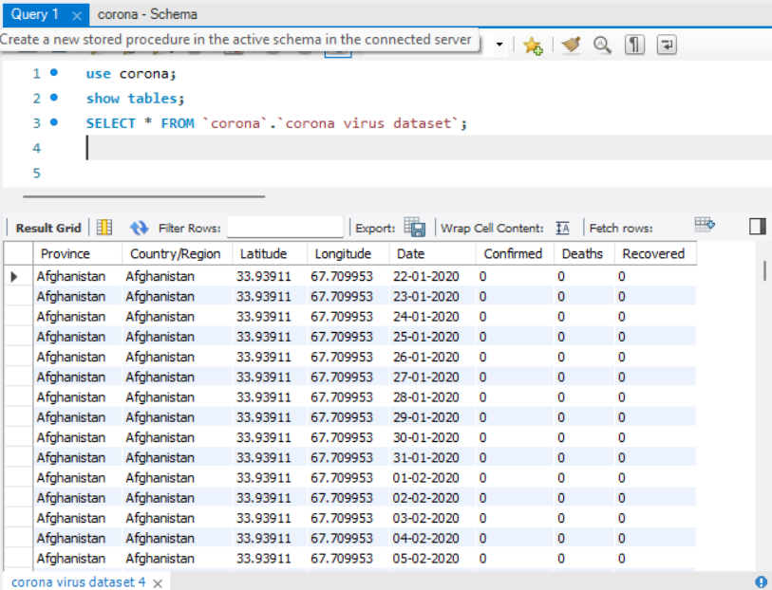
USE corona; : This command sets the active database to Corona.
SHOW TABLES; : This lists all tables within the Corona database.
SELECT * FROM `corona`. `corona virus dataset`; : This retrieves all columns and rows from the specified table.

Slide 7
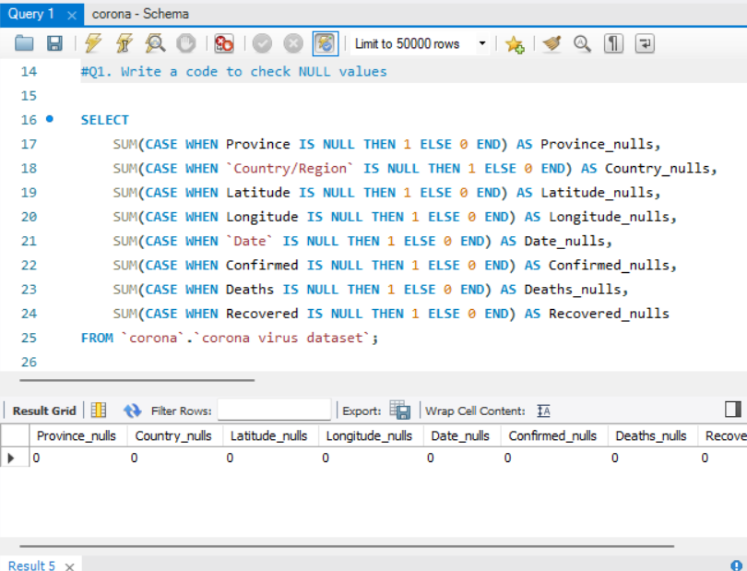
SUM(CASE WHEN ... THEN 1 ELSE 0 END): This counts the number of NULL values in each column by summing 1 for each NULL and 0 otherwise.
AS [column]_nulls: This assigns a label to the output of each column's NULL count for readability.

Slide 8
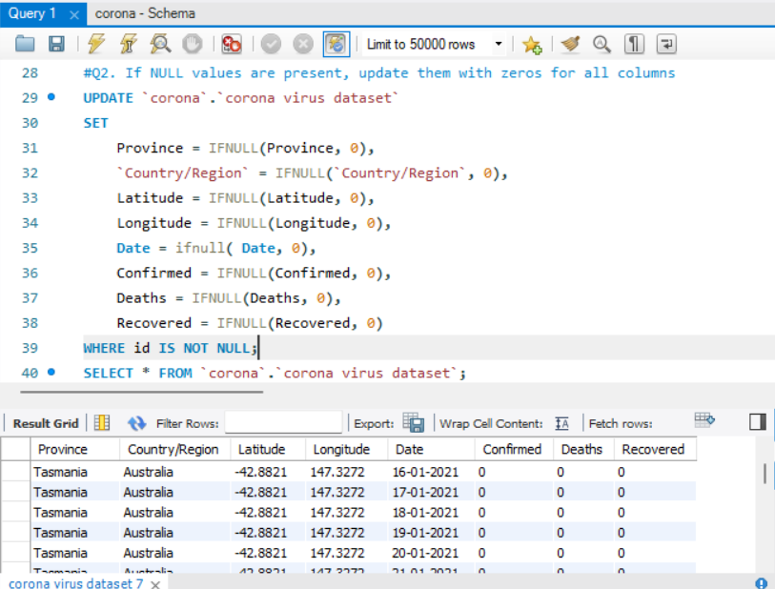
IFNULL(column, default_value): This function replaces NULL values in a column with a specified default value.
UPDATE ... SET ... WHERE 1=1: This updates all rows in the table since the condition 1=1 is always true.

Slide 9
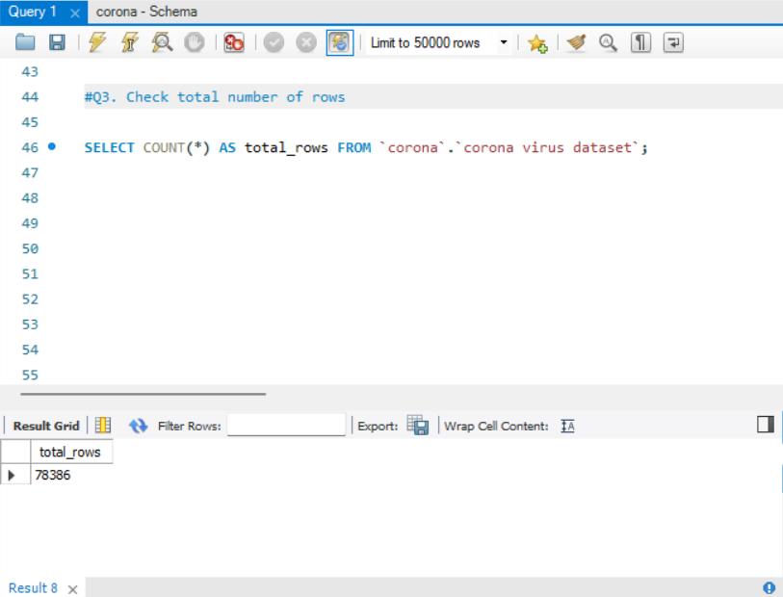
COUNT(*): This function counts all rows in the table.
AS total_rows: This assigns a label to the output for readability.

Slide 10
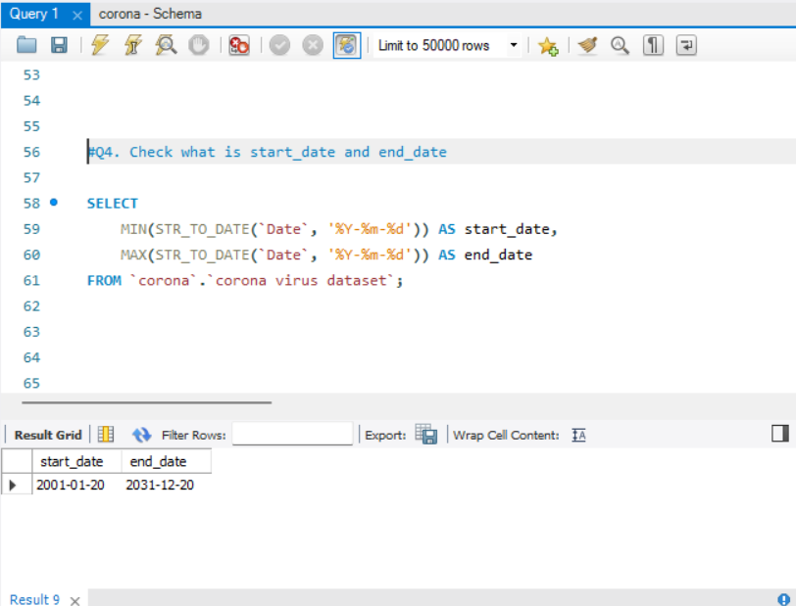
MIN(...), MAX(...): These functions find the minimum and maximum values in the specified column.
STR_TO_DATE(...): This function converts a string to a date format

Slide 11
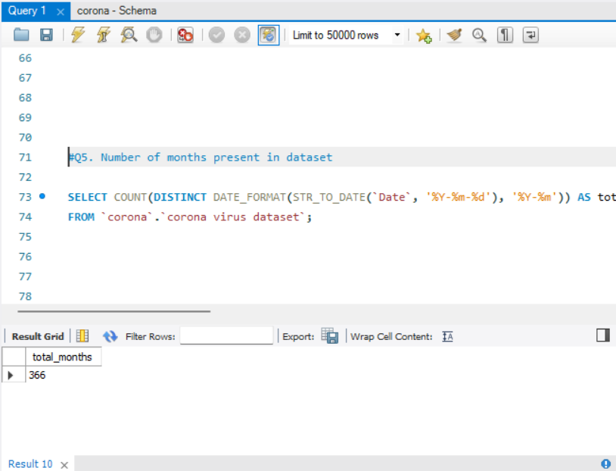
COUNT(DISTINCT ...): This counts the number of unique values.
DATE_FORMAT(..., '%Y-%m'): This formats the date to show only the year and month.

Slide 12
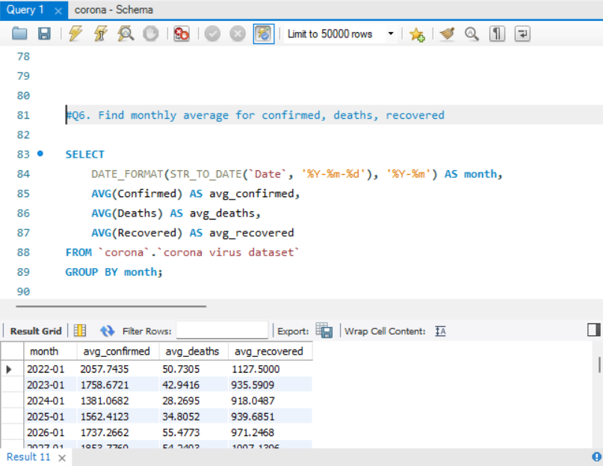
ROW_NUMBER() OVER (PARTITION BY ... ORDER BY ...): This window function assigns a unique number to each row within its
partition, ordered by the specified criteria.
WHERE rn = 1: This selects the row with the highest count within each month partition.

Slide 13
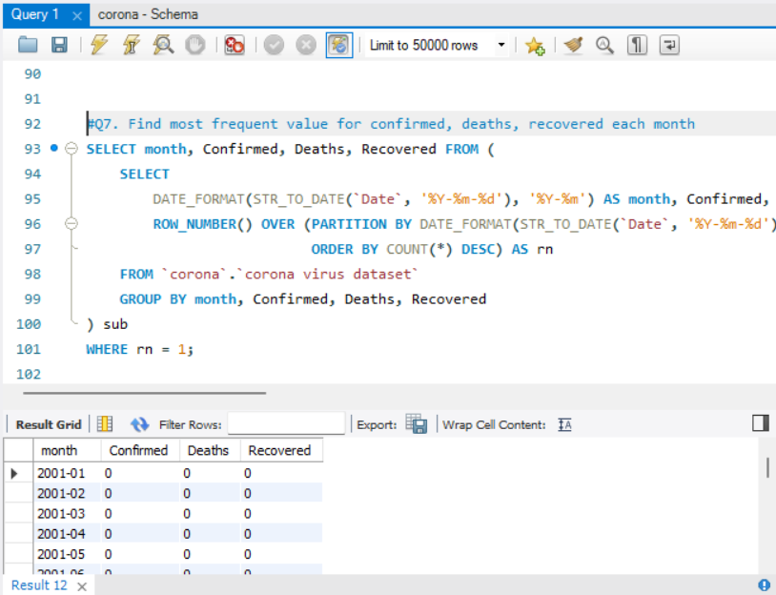
ROW_NUMBER() OVER (PARTITION BY ... ORDER BY ...): This window function assigns a unique number to each
row within its partition, ordered by the specified criteria.
WHERE rn = 1: This selects the row with the highest count within each month partition.

Slide 14
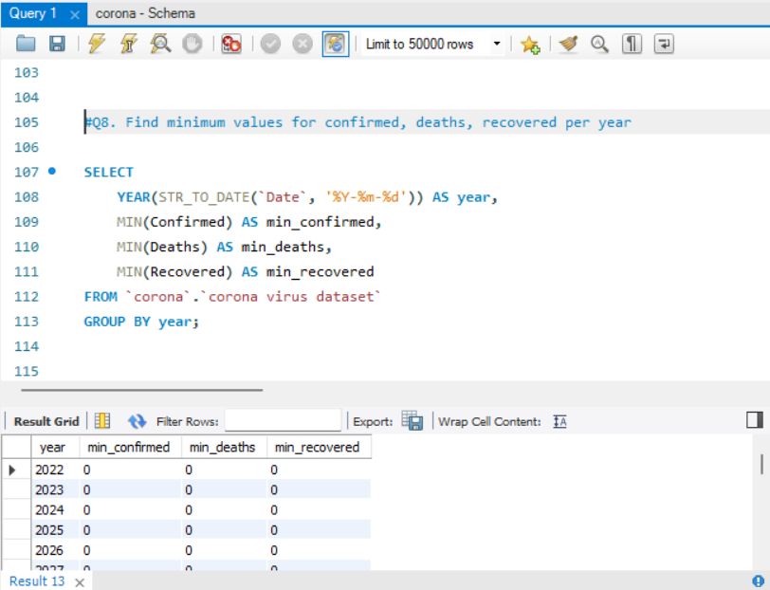
YEAR(...): This function extracts the year from a date.
MIN(...): This function finds the minimum value in the specified column.
GROUP BY year: This groups the results by year.

Slide 15
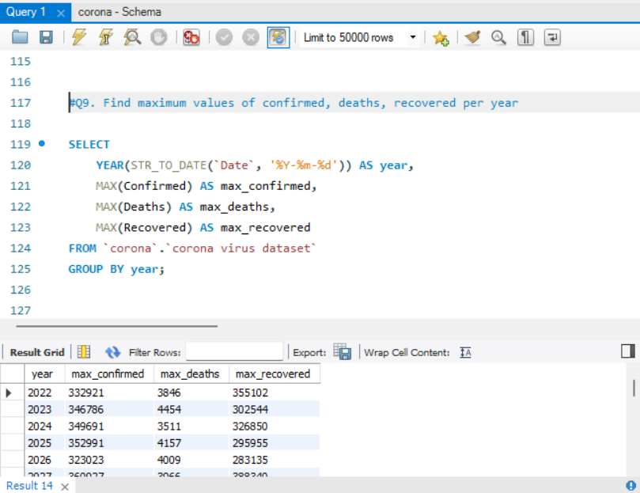
MAX(...): This function finds the maximum value in the specified column.

Slide 16
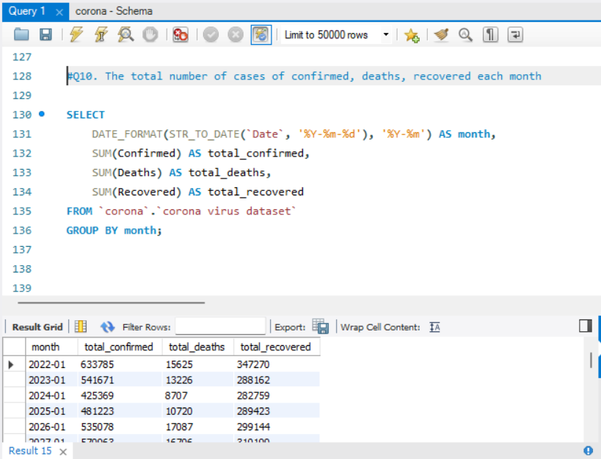
SUM(...): This function calculates the sum of the specified column.
GROUP BY month: This groups the results by month.

Slide 17
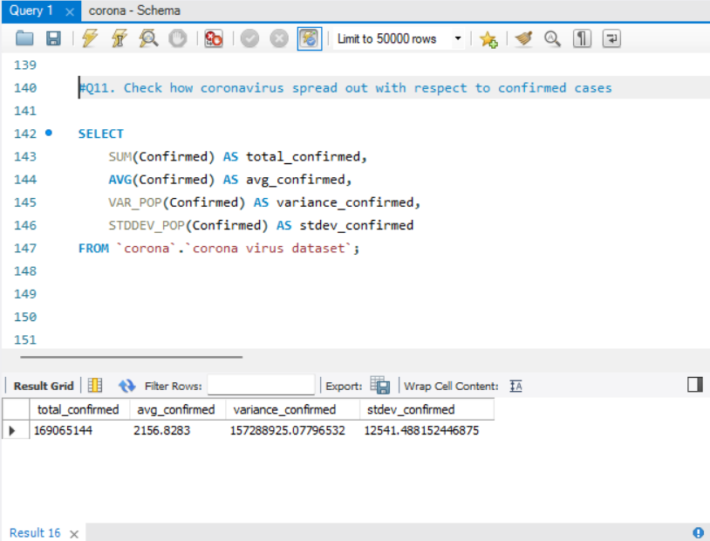
VAR_POP(...): This function calculates the population variance of the specified column.
STDDEV_POP(...): This function calculates the population standard deviation of the specified column.

Slide 18
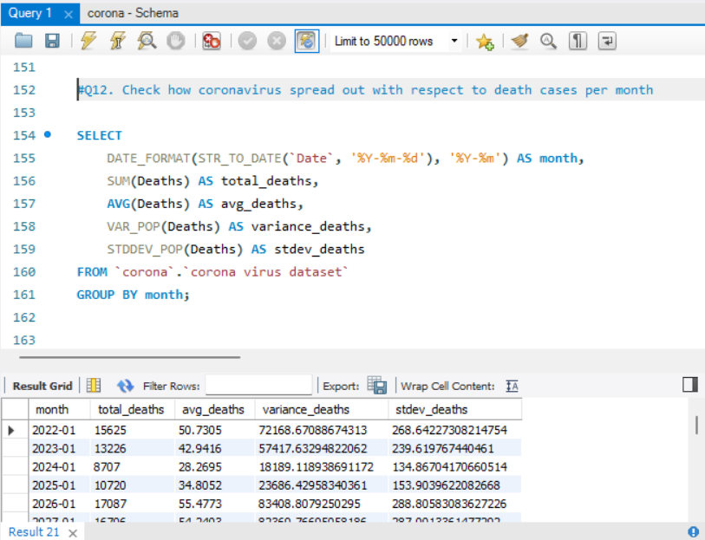
GROUP BY month: This groups the results by month.

Slide 19
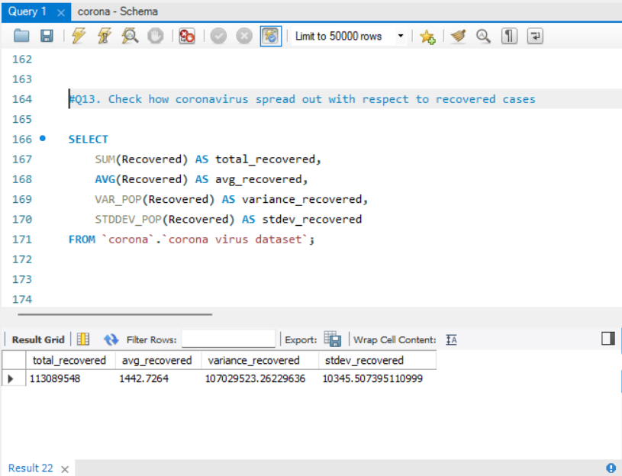
SUM(...), AVG(...), VAR_POP(...), STDDEV_POP(...): These functions calculate the sum, average, variance, and standard
deviation of the specified column.

Slide 20
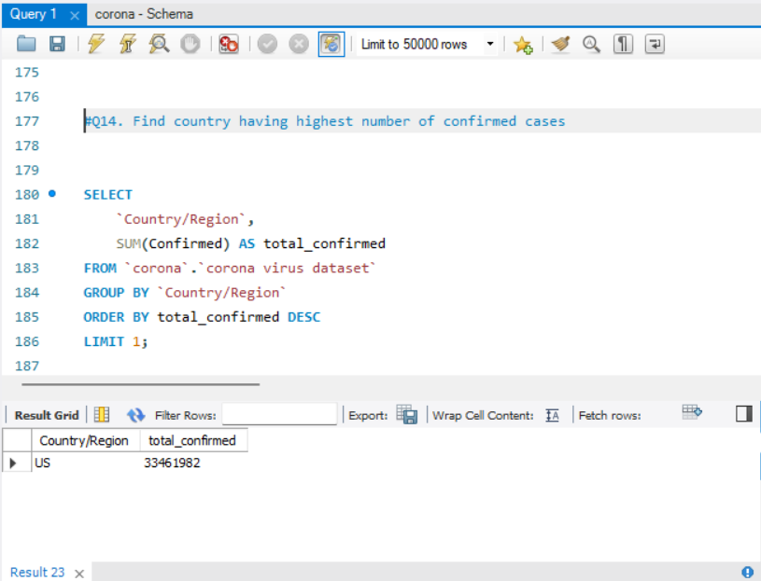
GROUP BY Country/Region: This groups the results by country.
ORDER BY total_confirmed DESC: This orders the results by the total number of confirmed cases in descending
order.
LIMIT 1: This limits the results to the top row.

Slide 21
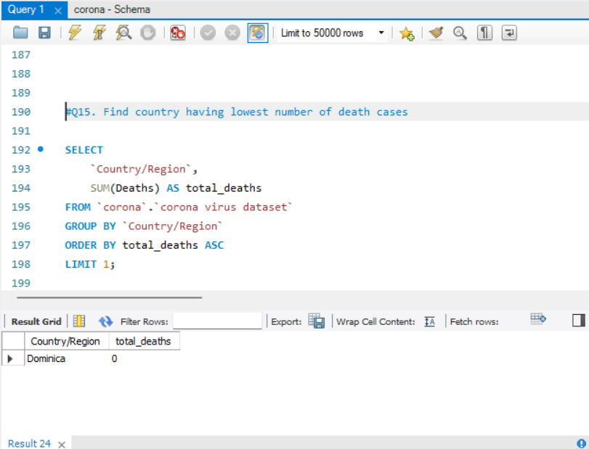
ORDER BY total_deaths ASC: This orders the results by the total number of death cases in ascending order.

Slide 22
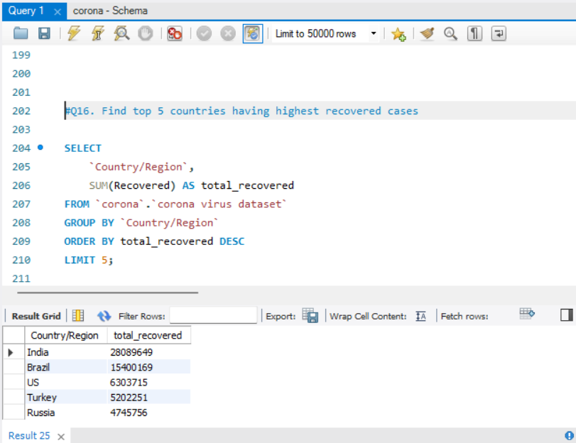
LIMIT 5: This limits the results to the top 5 rows.

Slide 23

Conclusion
Key Insights
Data-Driven Approach
This analysis will uncover key trends, assess the effectiveness of public health measures, and offer recommendations for managing COVID-19.
Using SQL and data analysis, this project aims to support efforts in combating the pandemic and preparing for future outbreaks.

Slide 24


